Slide 1
CSE421: Computer Graphics Sutherland-Hodgeman Polygon Clipping Algorithm
Mahimul Islam Nadim
Lecturer
Department Of CSE
Daffodil International University

Slide 2
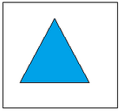
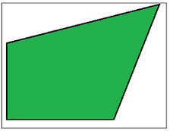
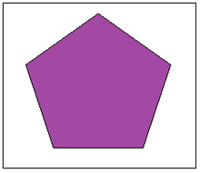
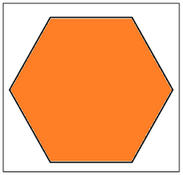
POLYGON
A Polygon can be described as the collection or group of closed lines.
All lines are connected.
Some Examples of the polygon:
Triangles
Pentagons
Hexagons

Slide 3
POLYGON CLIPPING
Polygon clipping is a process in which we only consider the part which is inside the view pane or window.
We will remove or clip the part that is outside the window.
We can use the following algorithms for polygon clipping–
Sutherland-Hodgeman polygon clipping algorithm
Weiler-Atherton polygon clipping algorithm

Slide 4
SUTHERLAND-HODGEMAN POLYGON CLIPPING ALGORITHM
This polygon clipping algorithm deals with four different clipping cases.
Left clip
Right clip
Top clip
Bottom clip

Slide 5
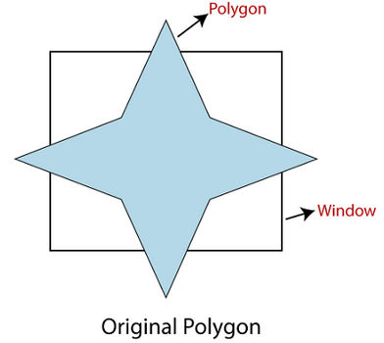
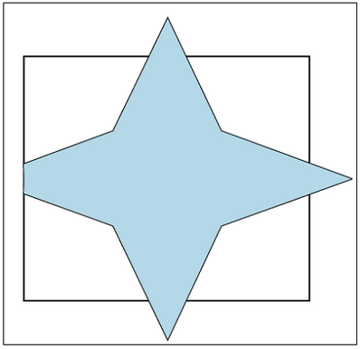
CASE-1: LEFT CLIP
In the left side polygon clipping,
- we only remove the left part of the polygon,
- which is outside the window.
We only save the portion which is inside the window.

Slide 6
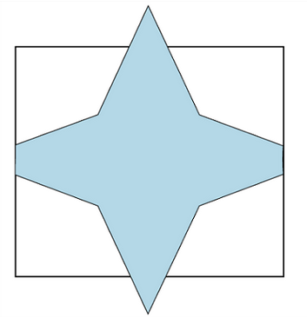
CASE-2: RIGHT CLIP
In the right-side polygon clipping,
- we only remove the right part of the polygon,
-which is outside the window.
We only save the portion which is inside the window.

Slide 7
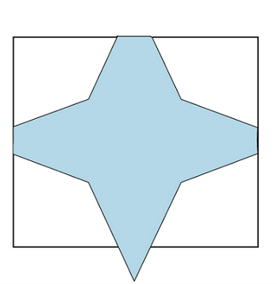
CASE-3: TOP CLIP
On the top side polygon clipping,
- we only remove the top part of the polygon,
- which is outside the window.
We only save the portion which is inside the window.

Slide 8
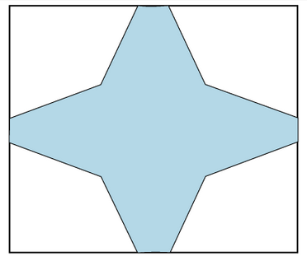
CASE-4: BOTTOM CLIP
In the bottom side polygon clipping,
- we only remove the bottom part of the polygon,
- which is outside the window.
We only save the portion which is inside the window.

Slide 9
CONDITIONS:
There should be the following conditions while we clip a polygon.
Condition 1(Out-In)
Condition 2(In-Out)
Condition 3(In-In)
Condition 4(Out-Out)

Slide 10
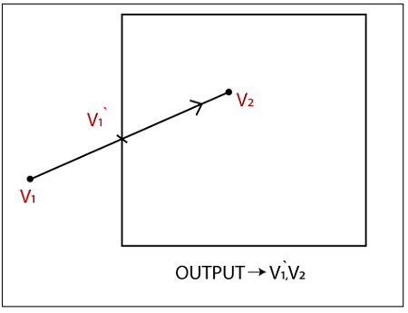
CONDITION 1(OUT-IN):
If the first vertex of the polygon is outside and the second vertex is inside the window,
then the output will be the intersection point and second vertex.

Slide 11
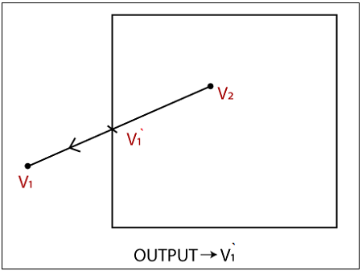
CONDITION 2(IN-OUT):
If the first vertex of the polygon is inside and the second vertex is outside the window,
then the output will be the intersection point.
V2‘
V2‘

Slide 12
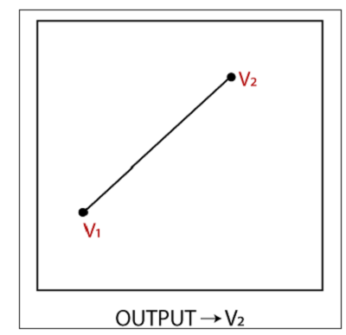
CONDITION 3(IN-IN):
If both vertices of the polygon are inside the window,
then the output will be the second vertex.

Slide 13
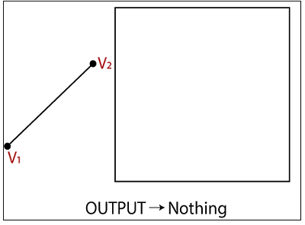
CONDITION 4(OUT-OUT):
If both vertices of the polygon are outside the window,
then the output will be nothing. It means we found a clipped polygon.

Slide 14
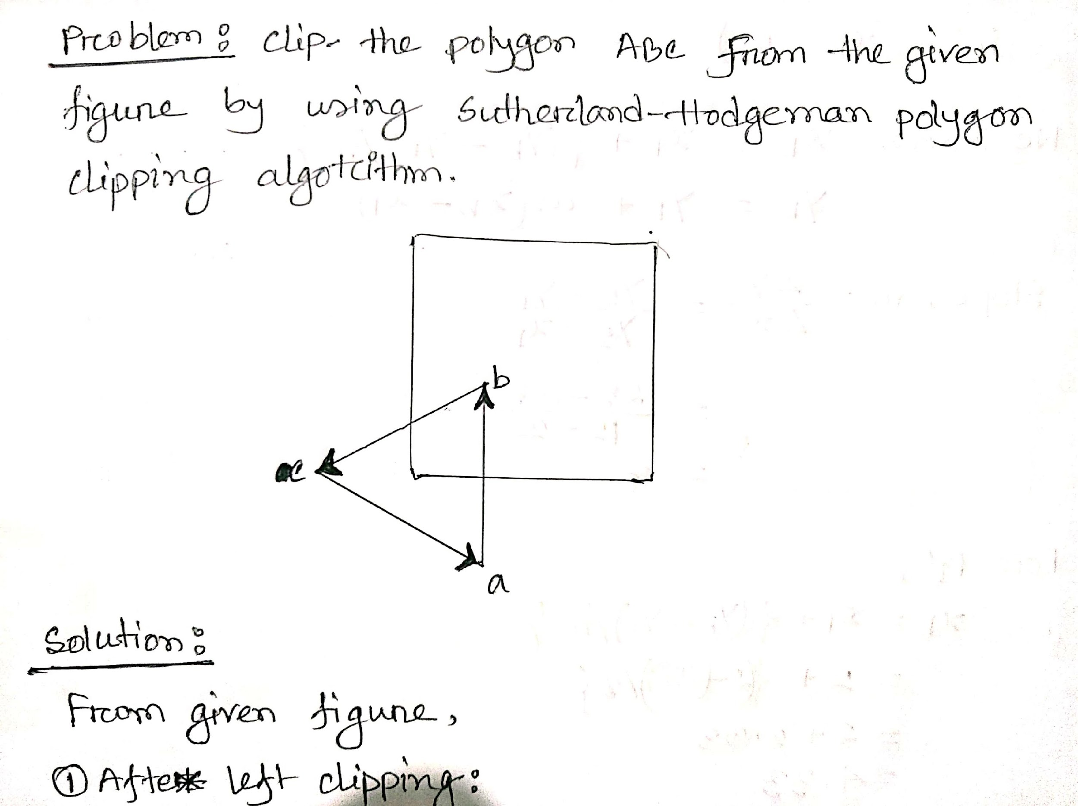
PRACTICE-1
Problem for practice:

Slide 15
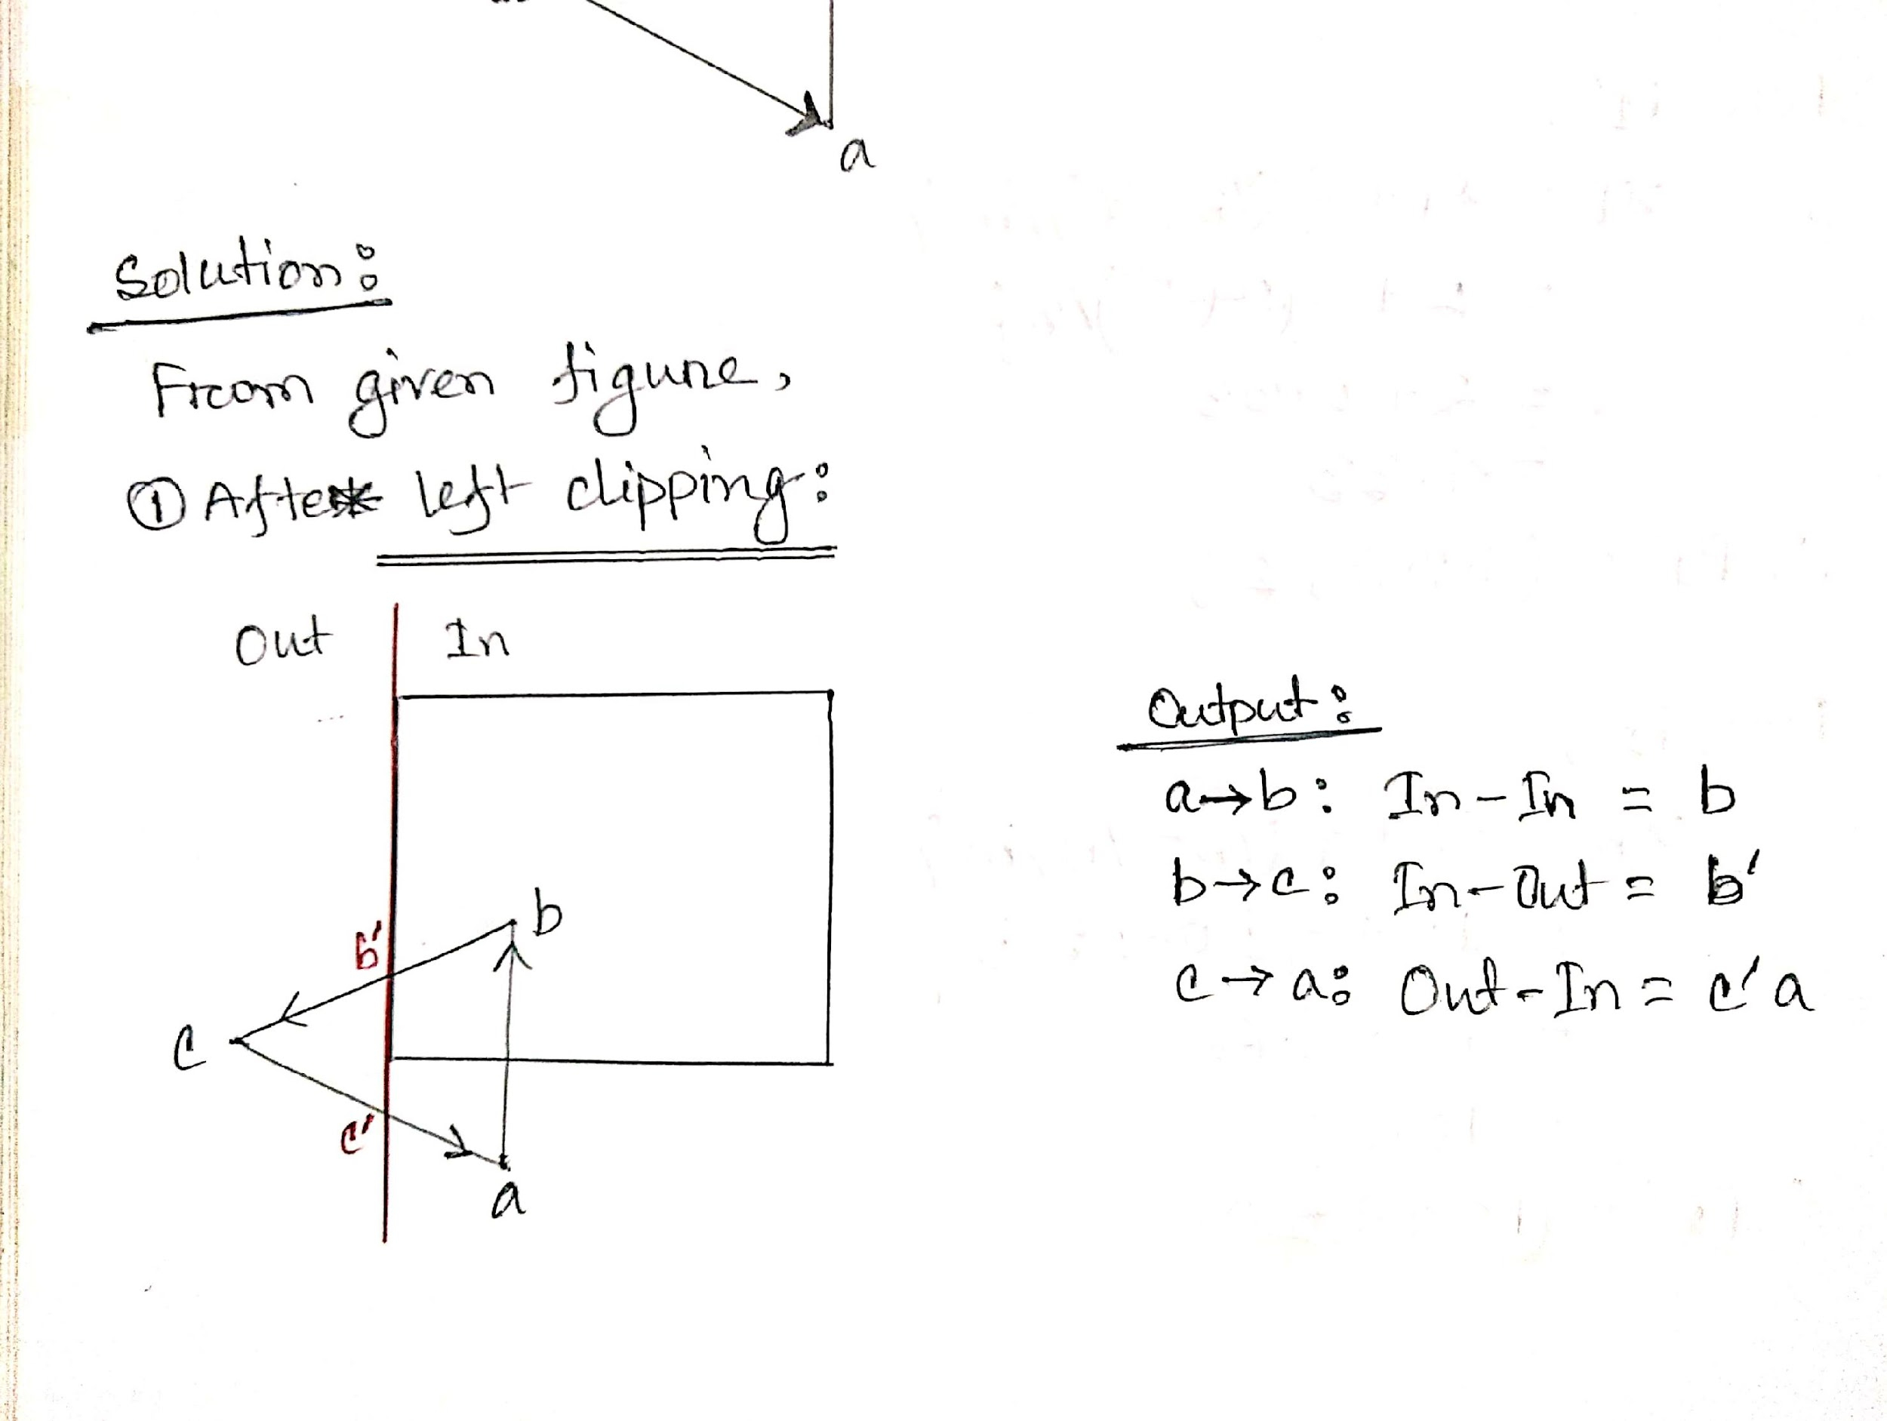
SOLUTION:
Condition wise Output— OUT-IN: Intersection Point And Second Vertex.
IN-OUT: Intersection point.
IN-IN : Second Vertex
OUT-OUT: Nothing
Left Clipping:

Slide 16
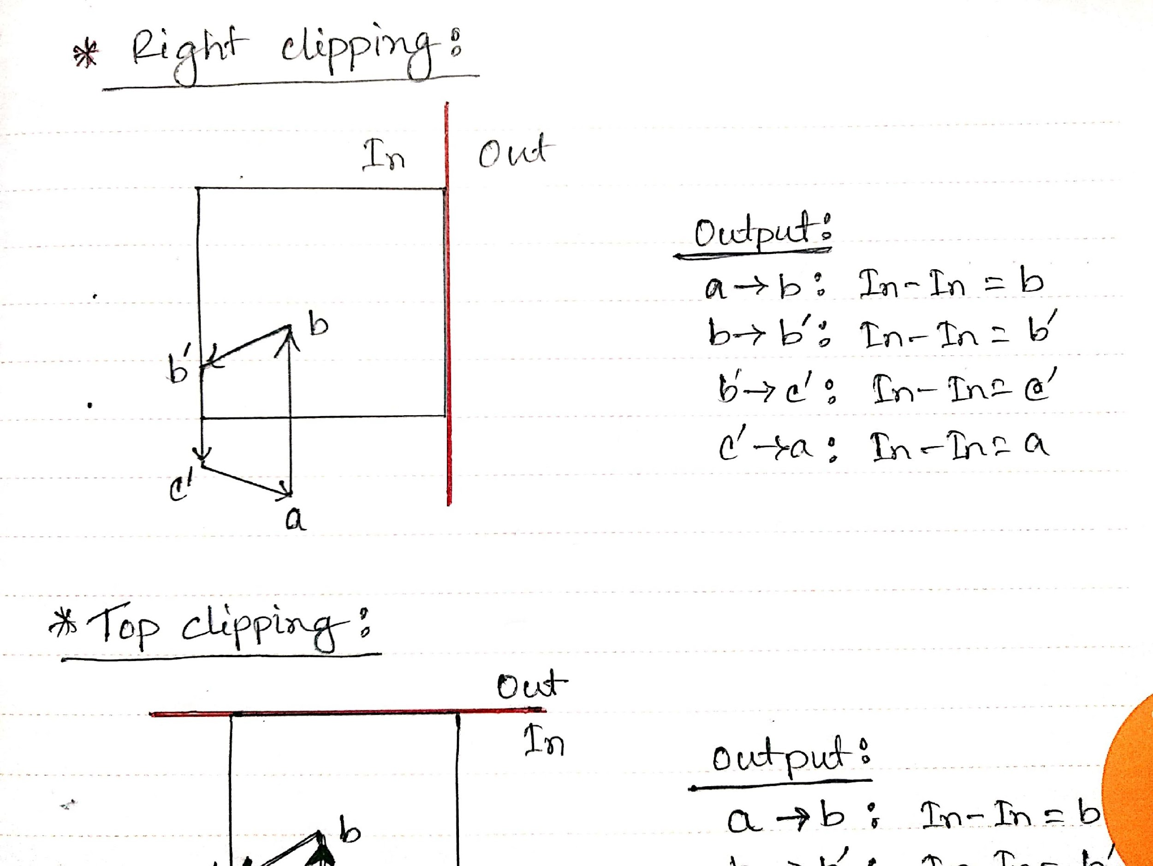
SOLUTION:
Condition wise Output— OUT-IN: Intersection Point And Second Vertex.
IN-OUT: Intersection point.
IN-IN : Second Vertex
OUT-OUT: Nothing
Right clipping:

Slide 17
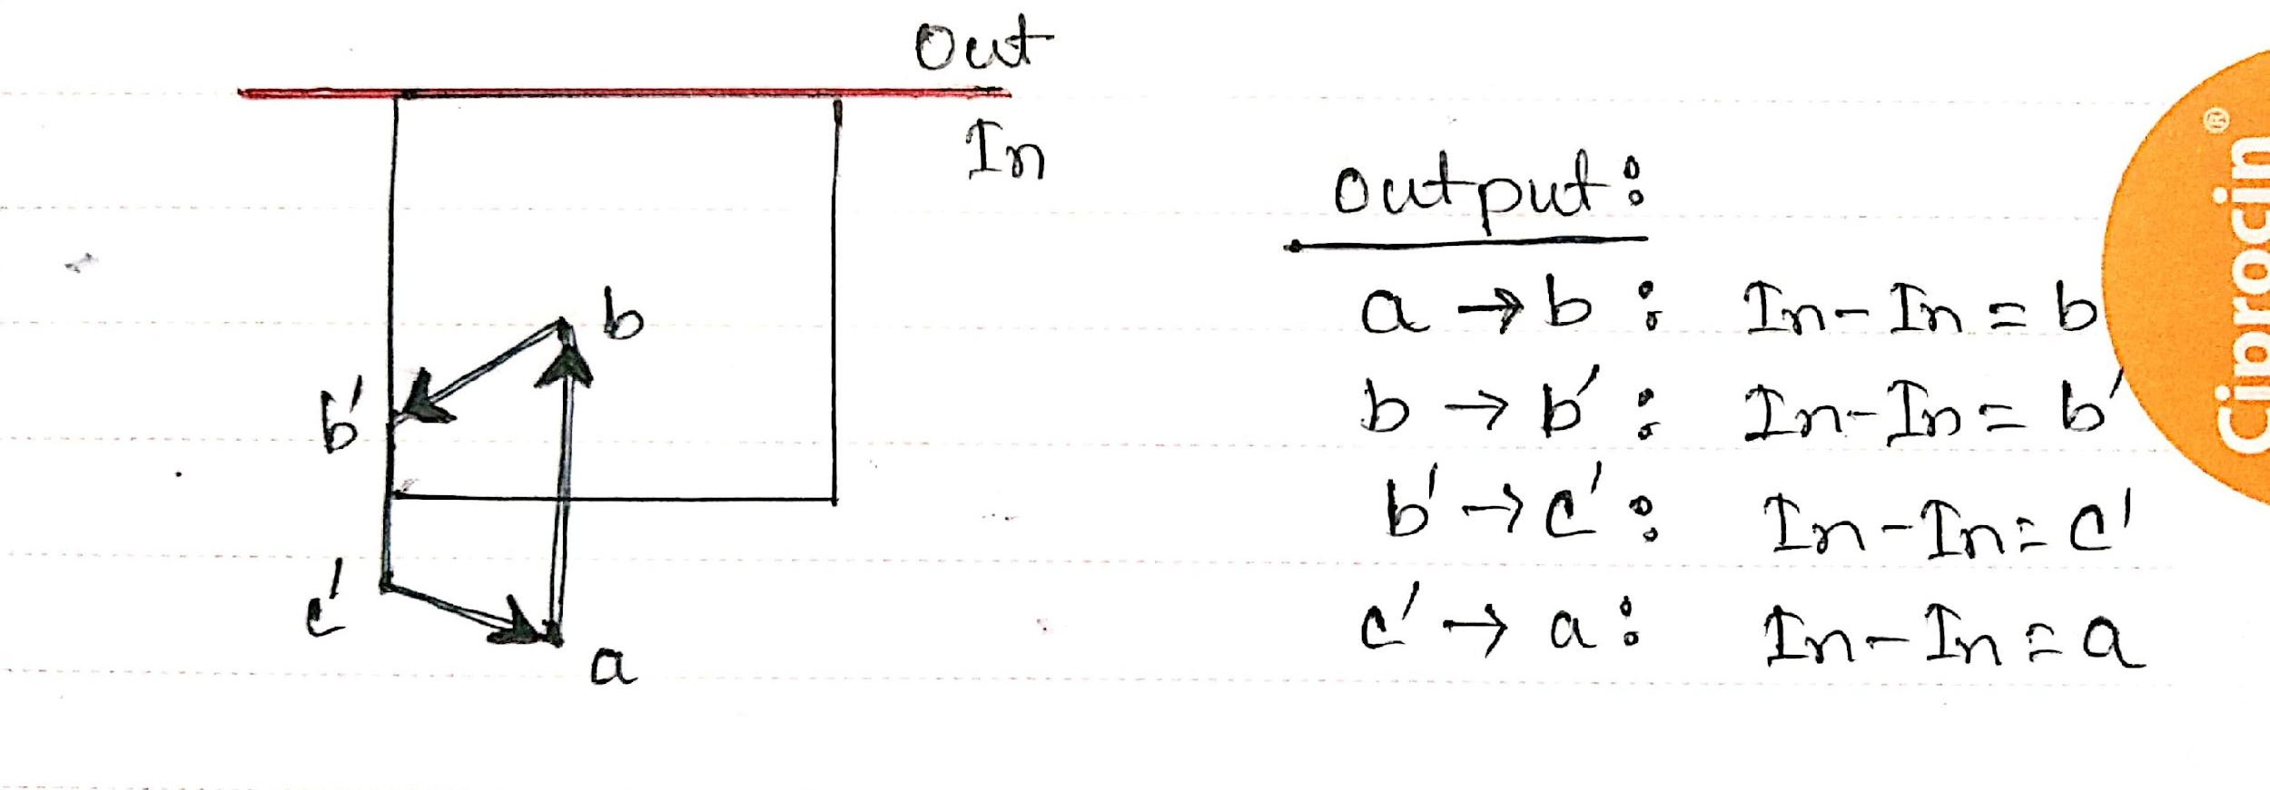
SOLUTION:
Condition wise Output— OUT-IN: Intersection Point And Second Vertex.
IN-OUT: Intersection point.
IN-IN : Second Vertex
OUT-OUT: Nothing
Top clipping:

Slide 18
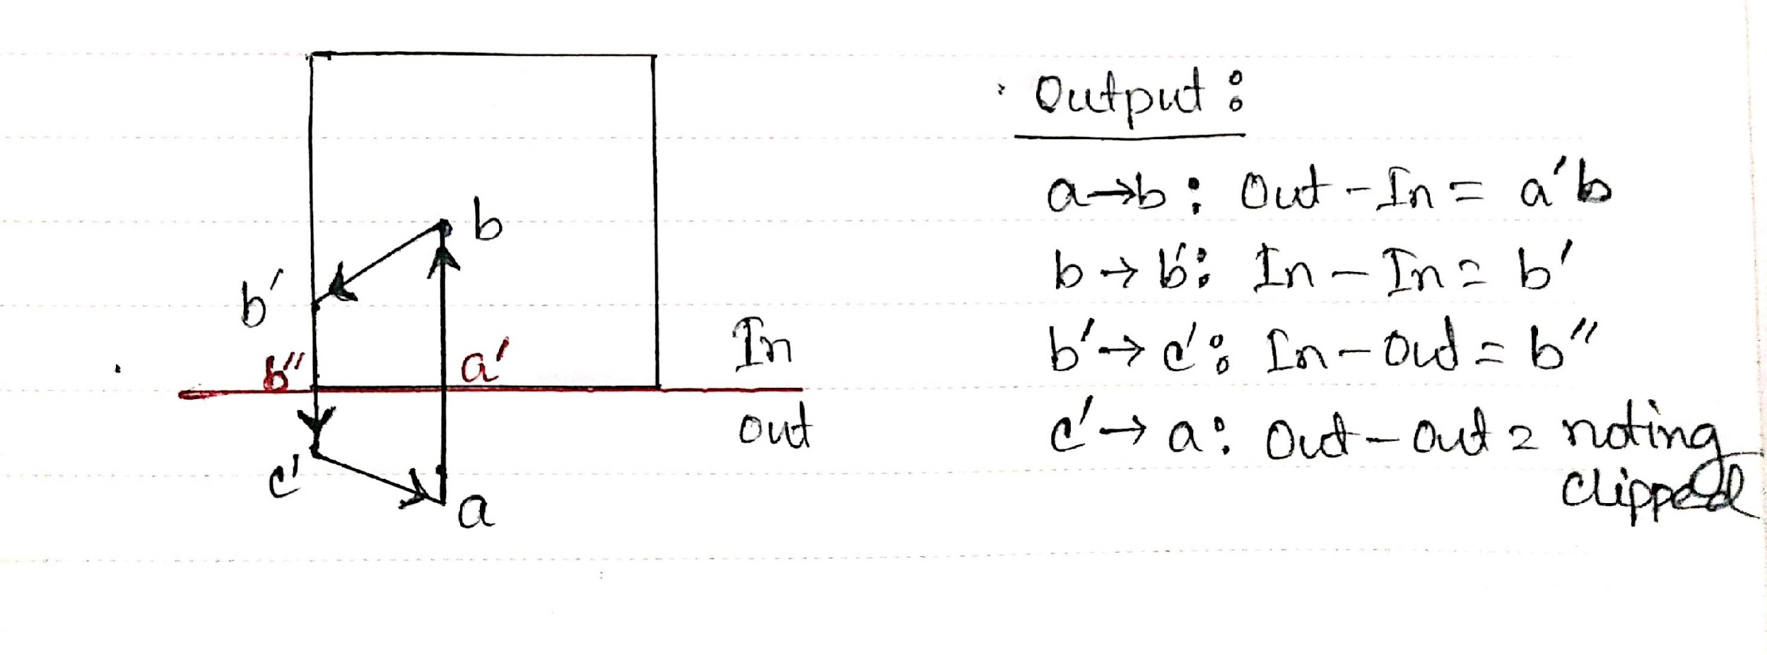
SOLUTION:
Condition wise Output— OUT-IN: Intersection Point And Second Vertex.
IN-OUT: Intersection point.
IN-IN : Second Vertex
OUT-OUT: Nothing
Bottom clipping:

Slide 19
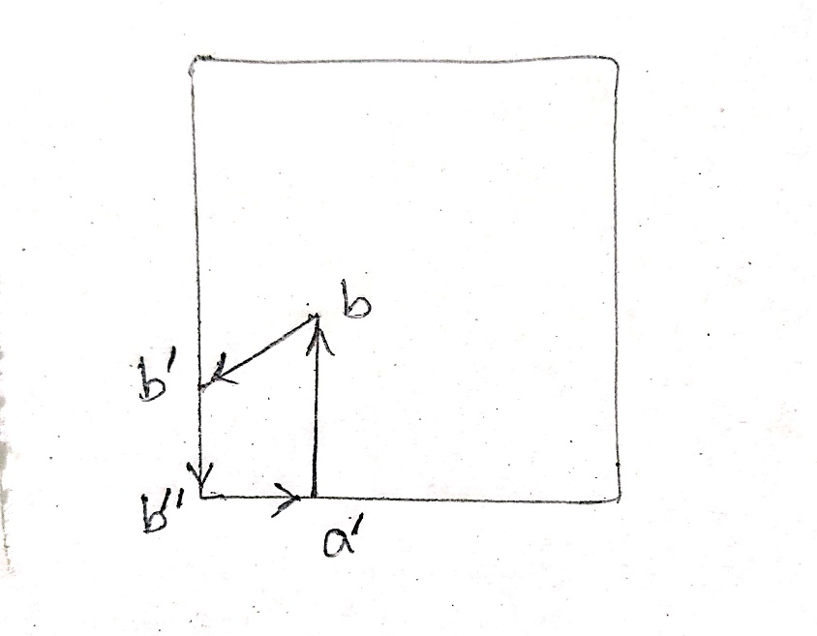
SOLUTION:
After clipping:

Slide 20
Thank You…

